Slide 1
Strategic Growth In Entrepreneurship
Entrepreneurship

Slide 2

The Nature of Planning in Emerging Firms
Most entrepreneurs’ planning for their ventures is informal and unsystematic.
The need for formal, systematic planning arises when:
  The firm is expanding with constantly increasing personnel size and market operations
  A high degree of uncertainty exists
  There is strong competition
  There is a lack of adequate experience, either technological or business

Slide 3

Strategic Planning
Strategic Planning
  The formulation of long-range plans for the effective management of environmental opportunities and threats in light of a venture’s strengths and weaknesses.
  Includes:
    Defining the venture’s mission
    Specifying achievable objectives
    Developing strategies
    Setting policy guidelines

Slide 4
Strategic Planning (cont’d)
Basic Steps in Strategic Planning:
  Examine the internal and external environments of the venture (strengths, weaknesses, opportunities, threats).
  Formulate the venture’s long-range and short-range strategies (mission, objectives, strategies, policies).
  Implement the strategic plan (programs, budgets, procedures).
  Evaluate the performance of the strategy.
  Take follow-up action through continuous feedback.

Slide 5
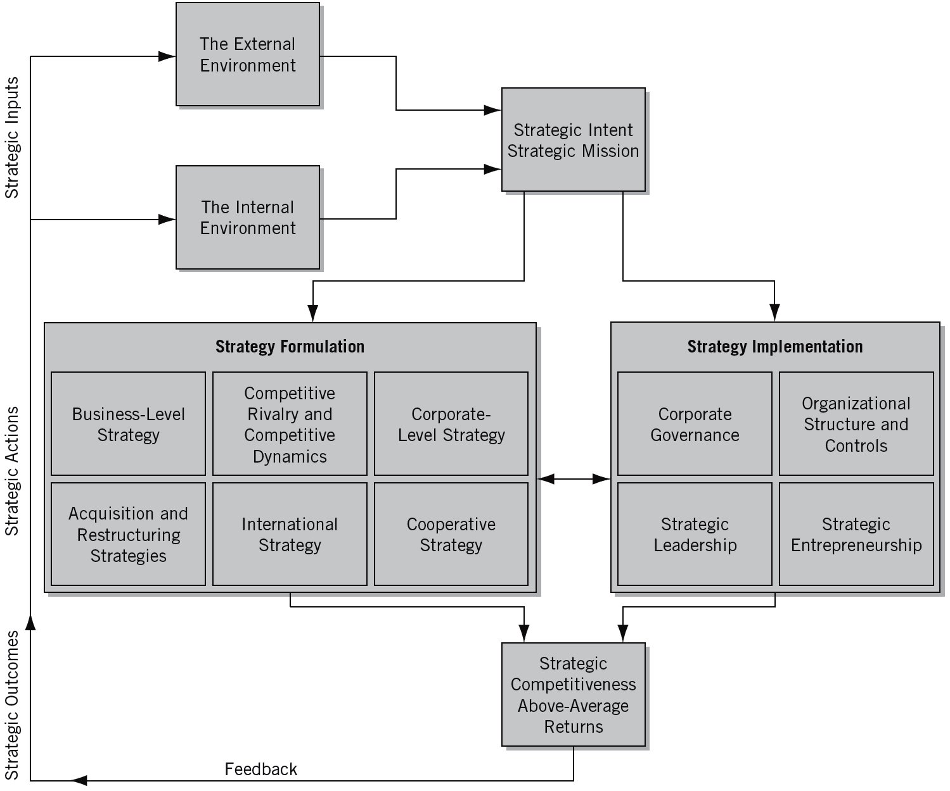
^{Figure} 13.1 The Strategic Management Process
Source: Michael A. Hitt, R. Duane Ireland, and Robert E. Hoskisson, Strategic Management: Competitiveness & Globalization, 8th ed. (Mason, OH: South-Western Publishing, 2009), 5. Reprinted with permission of South-Western, a division of Thomson Learning: www.thomsonrights.com.

Slide 6
Key Dimensions Influencing a Firm’s Strategic Planning Activities
Demand on strategic managers’ time
Decision-making speed
Problems of internal politics
Environmental uncertainty
The entrepreneur’s vision
  Step 1: Commitment to an open planning process.
  Step 2: Accountability to a corporate conscience.
  Step 3: Establishment of a pattern of subordinate
  participation in the development of the
  strategic plan.

Slide 7

The Lack of Strategic Planning
Reasons for the Lack of Strategic Planning
  Time scarcity
  Lack of knowledge
  Lack of expertise/skills
  Lack of trust and openness
  Perception of high cost

Slide 8
The Value of Strategic Planning
Findings of Strategic Planning Studies
  Strategic planning is of value to a venture and that planning influences a venture’s survival.
Benefits of Long-Range Planning
  Cost savings
  More efficient resource allocation
  Improved competitive position
  More timely information
  More accurate forecasts
  Reduced feelings of uncertainty
  Faster decision making
  Fewer cash-flow problems

Slide 9
Strategic Planning Levels (cont’d)
Strategic Planning Categories (Rue and Ibrahim)
  Category I: No written plan
  Category II: Moderately sophisticated planning
  Category III: Sophisticated planning
    Results: More than 88% of firms with Category II or III planning performed at or above the industry average compared with only 40% of firms with Category I planning.
All research indicates:
  Firms that engage in strategic planning are more effective than those that do not.
  The planning process, rather than merely the plans, is a key to successful performance.

Slide 10
Fatal Visions in Strategic Planning
Fatal mistakes that entrepreneurs fall prey to in their attempt to implement a strategy:
  Fatal Vision #1: Misunderstanding industry
  attractiveness
  Fatal Vision #2: No real competitive advantage
  Fatal Vision #3: Pursuing an unattainable competitive
  position
  Fatal Vision #4: Compromising strategy for growth
  Fatal Vision #5: Failure to explicitly communicate the venture’s strategy to employees
Creates unity; consistency of action; all depts work towards same goal

Slide 11
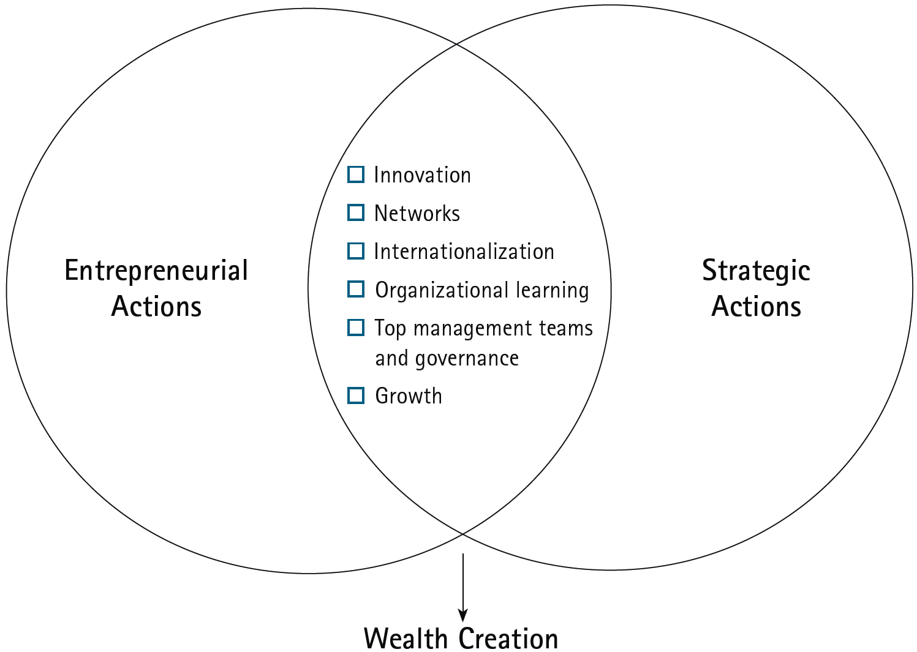
^{Figure} 13.2 The Integration of Entrepreneurial and Strategic Actions
Source: R. Duane Ireland, Michael A. Hitt, S. Michael Camp, and Donald L. Sexton, “Integrating Entrepreneurship and Strategic Management Actions to Create Firm Wealth,” Academy of Management Executive 15(1) (February 2001): 51.

Slide 12
Strategic Positioning:
The Entrepreneurial Edge
Strategic Positions
  Are often not obvious, and finding them requires creativity and insight.
  Are unique positions that have been available but simply overlooked by established competitors.
  Can help entrepreneurial ventures prosper by occupying a position that a competitor once held but has ceded through years of imitation and straddling.

Slide 13

^{Table} 13.1 Strategic Approaches: Position, Leverage, Opportunities
 | Position | Leverage | Opportunities
Strategic Logic | Establish position | Leverage resources | Pursue opportunities
Strategic Steps | Identify an attractive market Locate a defensible position Fortify and defend | Establish a vision Build resources Leverage across markets | Jump into the confusion Keep moving Seize opportunities Finish strong
Strategic Question | Where should we be? | What should we be? | How should we proceed?
Source Of Advantage | Unique, valuable position with tightly integrated activity system | Unique, valuable, inimitable resources | Key processes and unique simple rules
Works Best In | Slowly changing, well-structured markets | Moderately changing, well-structured markets | Rapidly changing, ambiguous markets
Duration Of Advantage | Sustained | Sustained | Unpredictable
Risk | It will be too difficult to alter position as conditions change | Company will be too slow to build new resources as conditions change | Managers will be too tentative in executing on promising opportunities
Performance Goal | Profitability | Long-term dominance | Growth
Source: Reprinted by permission of Harvard Business Review from “Strategy as Simple Rules,” by Kathleen M. Eisenhardt and Donald N. Sull (January 2001): 109. Copyright © 2001 by the Harvard Business School Publishing Corporation; all rights reserved.

Slide 14
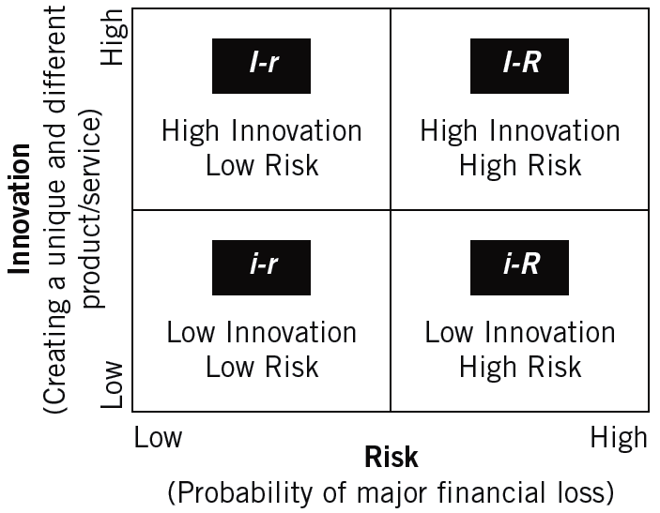
^{Figure} The Entrepreneurial Strategy Matrix: Independent Variables
Source: Matthew C. Sonfield and Robert N. Lussier, “The Entrepreneurial Strategic Matrix: A Model for New and Ongoing Ventures.” Reprinted with permission from Business Horizons, May/June 1997, by the trustees at Indiana University, Kelley School of Business.

Slide 15
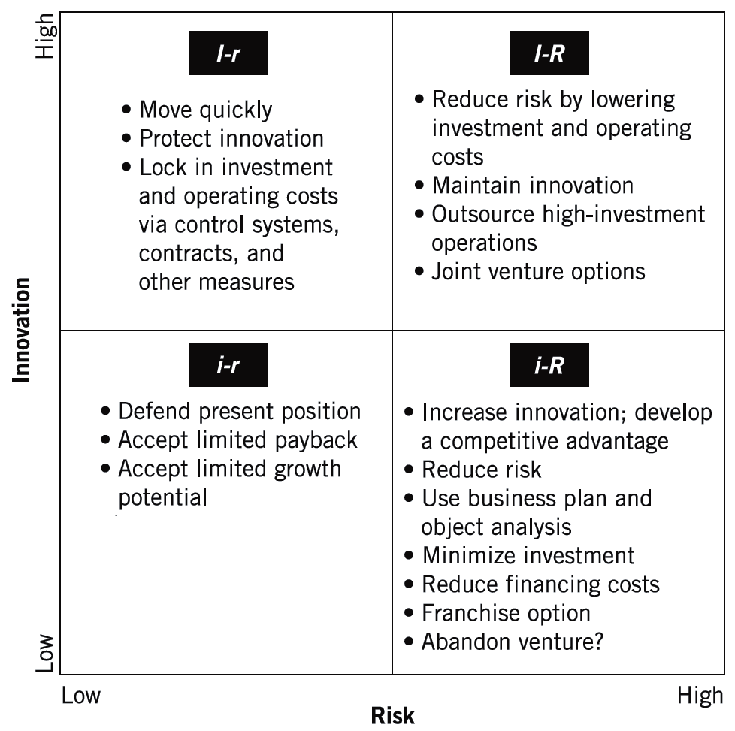
^{Figure} The Entrepreneurial Strategy Matrix: Appropriate Strategies
Source: Matthew C. Sonfield and Robert N. Lussier, “The Entrepreneurial Strategic Matrix: A Model for New and Ongoing Ventures.” Reprinted with permission from Business Horizons, May/June 1997, by the trustees at Indiana University, Kelley School of Business.

Slide 16
Venture Development Stages
Life-Cycle Stages of an Enterprise (Chandler)
  Initial expansion and accumulation of resources
  Rationalization of the use of resources
  Expansion into new markets to assure the continued use of resources
  Development of new structures to ensure continuing mobilization of resources

Slide 17
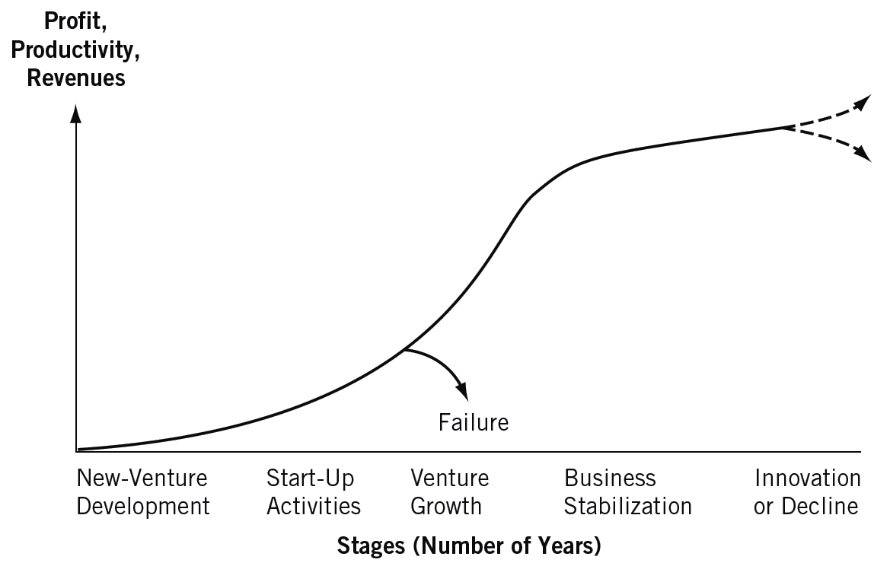
^{Figure} 13.5 A Venture’s Typical Life Cycle

Slide 18
The Entrepreneurial Company in the Twenty-First Century
Major Challenges:
  Building dynamic capabilities that are differentiated from those of emerging competitors
  Internal—utilization of the creativity and knowledge from employees
  External—the search for external competencies to complement the firm’s existing capabilities.

Slide 19
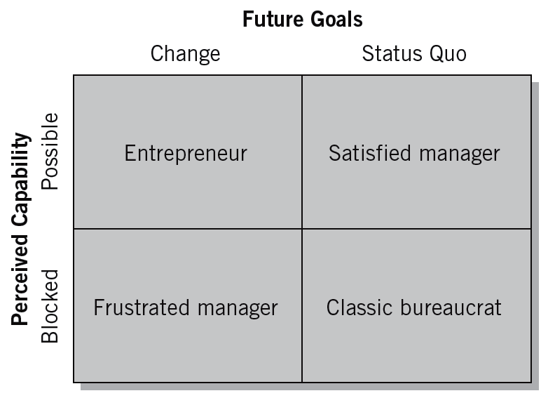
^{Figure} 13.6 The Entrepreneurial Mindset
© 2012 Cengage Learning. All rights reserved.

Slide 20
^{Table} 13.2 The Managerial versus the Entrepreneurial Mind-Set
 | Managerial Mind-Set | Entrepreneurial Mind-Set
Decision-making assumptions | The past is the best predictor of the future. Most business decisions can be quantified. | A new idea or an insight from a unique experience is likely to provide the best estimate of emerging trends.
Values | The best decisions are those based on quantitative analyses. Rigorous analyses are highly valued for making critical decisions. | New insights and real-world experiences are more highly valued than results based on historical data.
Beliefs | Law of large numbers: Chaos and uncertainty can be resolved by systematically analyzing the right data. | Law of small numbers: A single incident or several isolated incidents quickly become pivotal for making decisions regarding future trends.
Approach to problems | Problems represent an unfortunate turn of events that threaten financial projections. Problems must be resolved with substantiated analyses. | Problems represent an opportunity to detect emerging changes and possibly new business opportunities.
Source: Mike Wright, Robert E. Hoskisson, and Lowell W. Busenitz, “Firm Rebirth: Buyouts as Facilitators of Strategic Growth and Entrepreneurship,” Academy of Management Executive 15(1): 114.
© 2012 Cengage Learning. All rights reserved.

Slide 21
Building the Adaptive Firm
An Adaptive Firm
  One that Increases opportunity for its employees, initiates change, and instills a desire to be innovative.
How to remain adaptive and innovative:
  Share the entrepreneur’s vision
  Increase the perception of opportunity
  Institutionalize change as the venture’s goal
  Instill the desire to be innovative:
    A reward system
    An environment that allows for failure
    Flexible operations
    The development of venture teams

Slide 22

The Transition from an Entrepreneurial Style to a Managerial Approach
Impediments to Transition:
  A highly centralized decision-making system
  An overdependence on one or two key individuals,
  An inadequate repertoire of managerial skills and training
  A paternalistic atmosphere

Slide 23
^{Table} 13.3 The Entrepreneurial Culture versus the Administrative Culture
 | Entrepreneurial Focus |  | Administrative Focus
 | Characteristics | Pressures | Characteristics | Pressures
Strategic Orientation | Driven by perception of opportunity | Diminishing opportunities Rapidly changing technology, consumer economics, social values, and political rules | Planning systems and cycles | Social contracts Performance measurement criteria
Commitment to Seize Opportunities | Revolutionary, with short duration | Action orientation Narrow decision windows Acceptance of reasonable risks Few decision constituencies | Evolutionary, with long duration | Acknowledgement of multiple constituencies Negotiation about strategic course Risk reduction Coordination with existing resource base
Commitment of Resources | Many stages, with minimal exposure at each stage | Lack of predictable resource needs Lack of control over the environment Social demands for appropriate use of resources Foreign competition Demands for more efficient use | A single stage, with complete commitment out of decision | Need to reduce risk Incentive compensation Turnover in managers Capital budgeting systems Formal planning systems
Control of Resources | Episodic use or rent of required resources | Increased resource specialization Long resource life compared with need Risk of obsolescence Risk inherent in the identified opportunity Inflexibility of permanent commitment to resources | Ownership or employment of required resources | Power, status, and financial rewards Coordination of activity Efficiency measures Inertia and cost of change Industry structures
Management Structure | Flat, with multiple informal networks | Coordination of key noncontrolled resources Challenge to hierarchy Employees’ desire for independence | Hierarchy | Need for clearly defined authority and responsibility Organizational culture Reward systems Management theory
Source: Reprinted by permission of the Harvard Business Review. An exhibit from “The Heart of Entrepreneurship,” by Howard H. Stevenson and David E. Gumpert, March/April 1985, 89. Copyright © 1985 by the President and Fellows of Harvard College; all rights reserved.

Slide 24
Balancing the Focus—Entrepreneurial versus Manager (Stevenson and Gumpert)
The Entrepreneur’s
Point of View
  Where is the opportunity?
  How do I capitalize on it?
  What resources do I need?
  How do I gain control over them?
  What structure is best?
The Administrative
Point of View
  What resources do I control?
  What structure determines our organization’s relationship to its market?
  How can I minimize the impact of others on my ability to perform?
  What opportunity is appropriate?

Slide 25
Understanding the Growth Stage
Key Factors During the Growth Stage
  Control
    Does the control system imply trust?
    Does the resource allocation system imply trust?
    Is it easier to ask permission than to ask forgiveness?
  Responsibility
    Creating a sense of responsibility that establishes flexibility, innovation, and a supportive environment.
  Tolerance of failure
    Moral failure
    Personal failure
    Uncontrollable failure
  Change

Slide 26

Understanding the Growth Stage (cont’d)
Managing Paradox and Contradiction
  Bureaucratization versus decentralization
  Environment versus strategy
  Strategic emphases: Quality versus cost versus innovation
© 2012 Cengage Learning. All rights reserved.

Slide 27
Confronting the Growth Wall
Successful growth-oriented firms have exhibited consistent themes:
  The entrepreneur is able to envision and anticipate the firm as a larger entity.
  The team needed for tomorrow is hired and developed today.
  The original core vision of the firm is constantly and zealously reinforced.
  “Big-company” processes are introduced gradually as supplements to, rather than replacements for, existing approaches.
  Hierarchy is minimized.
  Employees hold a financial stake in the firm.

Slide 28
Unique Managerial Concerns of Growing Ventures
Distinction
of Small Size
One-Person-Band
Syndrome
Continuous
Learning
Growing Venture
Time
Management
Community
Pressures

Slide 29
The International Environment:
Global Opportunities
Global Entrepreneurs
  Rely on global networks for resources, design, and distribution.
  Are adept at recognizing opportunities that require agility, certainty, and ingenuity with a global perspective.
  Must be global thinkers in order to design and adopt strategies for different countries.

Slide 30
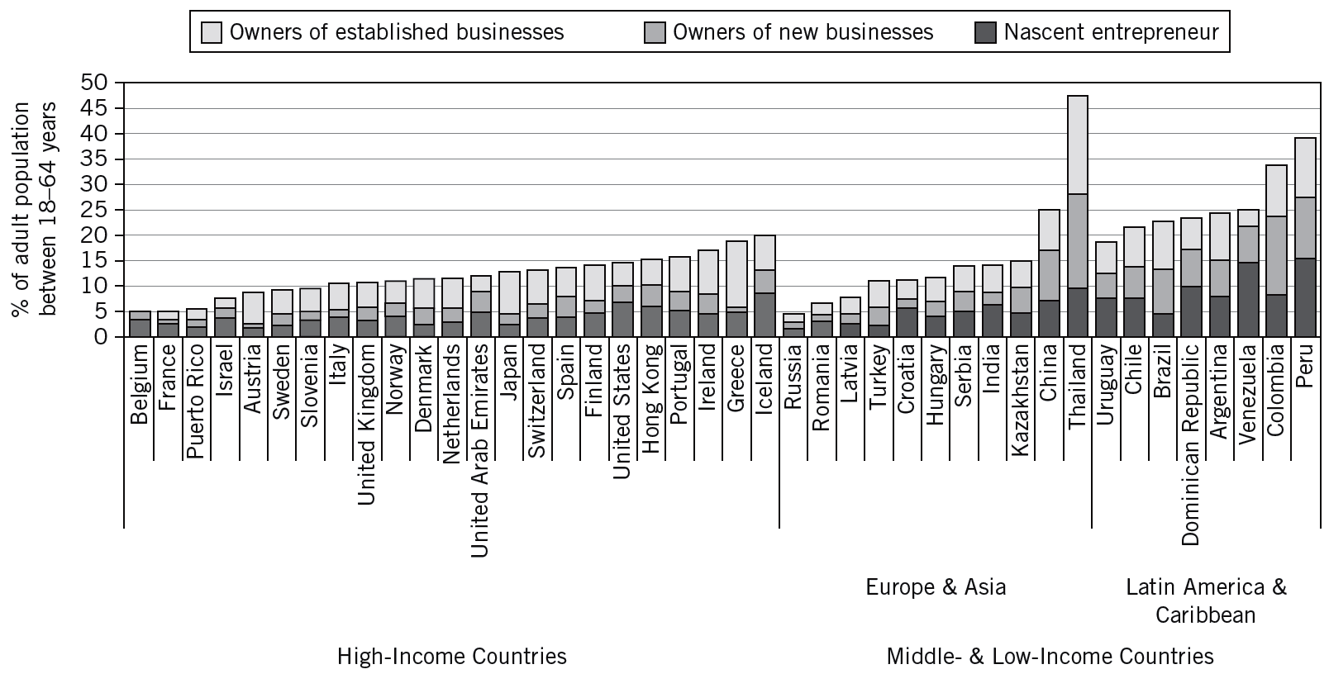
^{Figure} 13.7 Share of the World Population Engaged in Entrepreneurship
Source: Niels Bosma, Kent Jones, Erkko Autio, and Jonathan Levie, Global Entrepreneurship Monitor (Babson College, Babson Park, MA, and London Business School, London, 2007).

Slide 31
Achieving Entrepreneurial Leadership in the New Millennium
Entrepreneurial Leadership
  Arises when an entrepreneur attempts to manage the fast-paced, growth oriented company.
Components of Entrepreneurial Leadership
  Determining the firm’s purpose or vision.
  Exploiting and maintaining the core competencies.
  Developing human capital.
  Sustaining an effective organizational culture.
  Emphasizing ethical practices.
  Establishing balanced organizational controls.

Slide 32
^{Table} 13.4 Strategic, Visionary, and Managerial Leadership
STRATEGIC LEADERS
synergistic combination of managerial and visionary leadership
emphasis on ethical behavior and value-based decisions
oversee operating (day-to-day) and strategic (long-term) responsibilities
formulate and implement strategies for immediate impact and preservation of long-term goals to enhance organizational survival, growth, and long-term viability
have strong, positive expectations of the performance they expect from their superiors, peers, subordinates, and themselves
use strategic controls and financial controls, with emphasis on strategic controls
use, and interchange, tacit and explicit knowledge on individual and organizational levels
use linear and nonlinear thinking patterns
believe in strategic choice, that is, their choices make a difference in their organizations and environment

Slide 33
^{Table} 13.4 Strategic, Visionary, and Managerial Leadership
Visionary Leaders | Managerial Leaders
are proactive, shape ideas, change the way people think about what is desirable, possible, and necessary | are reactive; adopt passive attitudes toward goals; goals arise out of necessities, not desires and dreams; goals based on past
work to develop choices, fresh approaches to long standing problems; work from high-risk positions | view work as an enabling process involving some combination of ideas and people interacting to establish strategies
are concerned with ideas; relate to people in intuitive and empathetic ways | relate to people according to their roles in the decision-making process
feel separate from their environment; work in, but do not belong to, organizations; sense of who they are does not depend on work | see themselves as conservators and regulators of existing order; sense of who they are depends on their role in organization
influence attitudes and opinions of others within the organization | influence actions and decisions of those with whom they work
concerned with insuring future of organization, especially through development and management of people | involved in situations and contexts characteristic of day-to-day activities
more embedded in complexity, ambiguity, and information overload; engage in multifunctional, integrative tasks | concerned with, and more comfortable in, functional areas of responsibilities
know less than their functional area experts | expert in their functional area
more likely to make decisions based on values | less likely to make value-based decisions
more willing to invest in innovation, human capital, and creating and maintaining an effective culture to ensure long-term viability | engage in, and support, short-term, least-cost behavior to enhance financial performance figures
focus on tacit knowledge and develop strategies as communal forms of tacit knowledge that promote enactment of a vision | focus on managing the exchange and combination of explicit knowledge and ensuring compliance to standard operating procedures
utilize nonlinear thinking | utilize linear thinking
believe in strategic choice, that is, their choices make a difference in their organizations and environment | believe in determinism, that is, the choices they make are determined by their internal and external environments
Source: W. Glenn Rowe, “Creating Wealth in Organizations: The Role of Strategic Leadership,” Academy of Management Executive 15(1) (2001): 82.

Slide 34
Key Terms and Concepts
adaptive firm
entrepreneurial leadership
entrepreneurial strategy matrix
global entrepreneur
growth stage
growth wall
innovation
lack of expertise/skills
lack of knowledge
lack of trust and openness
life-cycle stages
moral failure
new-venture development
one-person-band syndrome
perception of high cost
personal failure
stabilization stage
start-up activities
strategic planning
strategic positioning
SWOT analysis
time scarcity
uncontrollable failure

